Slide 1

Data Science Foundations
Class 2: Exploration, Preprocessing & Evaluation
Ai Bootcamp

Slide 2
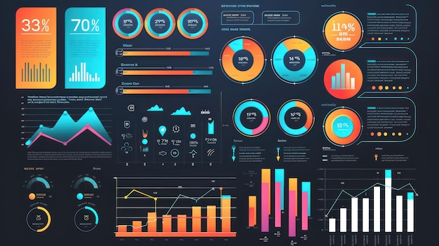

Slide 3
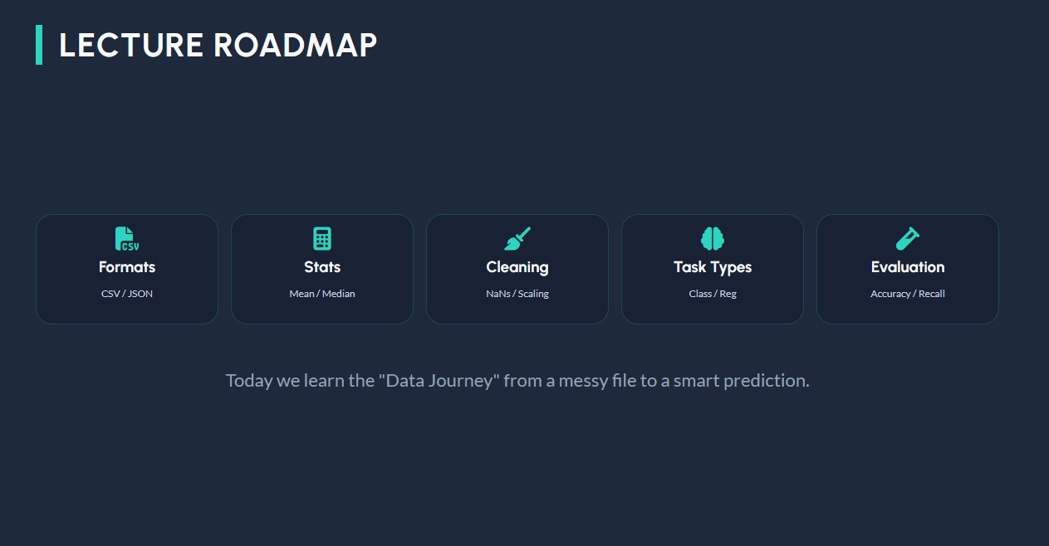

Slide 4

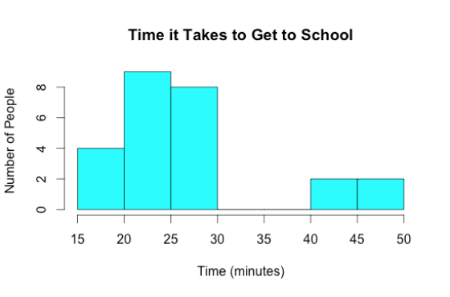
STEP 1: KNOW YOUR DATA TYPES
Numerical: Numbers you can calculate.
•
Continuous: 180.5 cm, 25.4°C
•
Discrete: 4 children, 10 cars
Categorical: Labels or groups.
•
Nominal: Gender, Eye color (No order)
•
Ordinal: Grades (A, B, C), Satisfaction levels

Slide 5
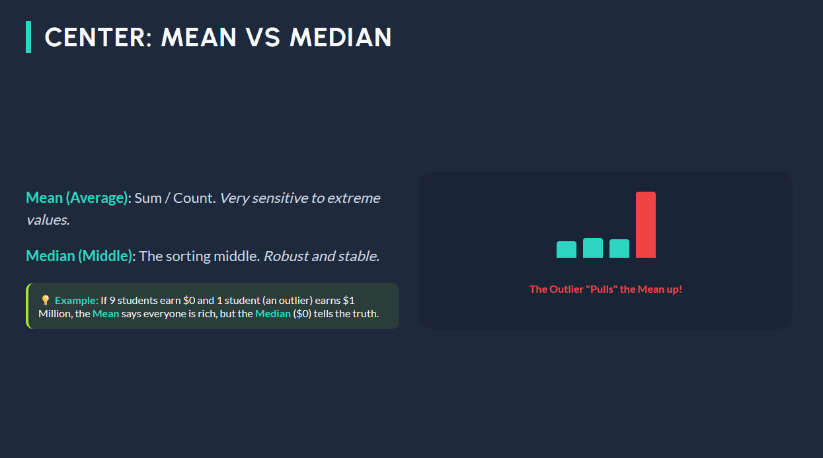

Slide 6
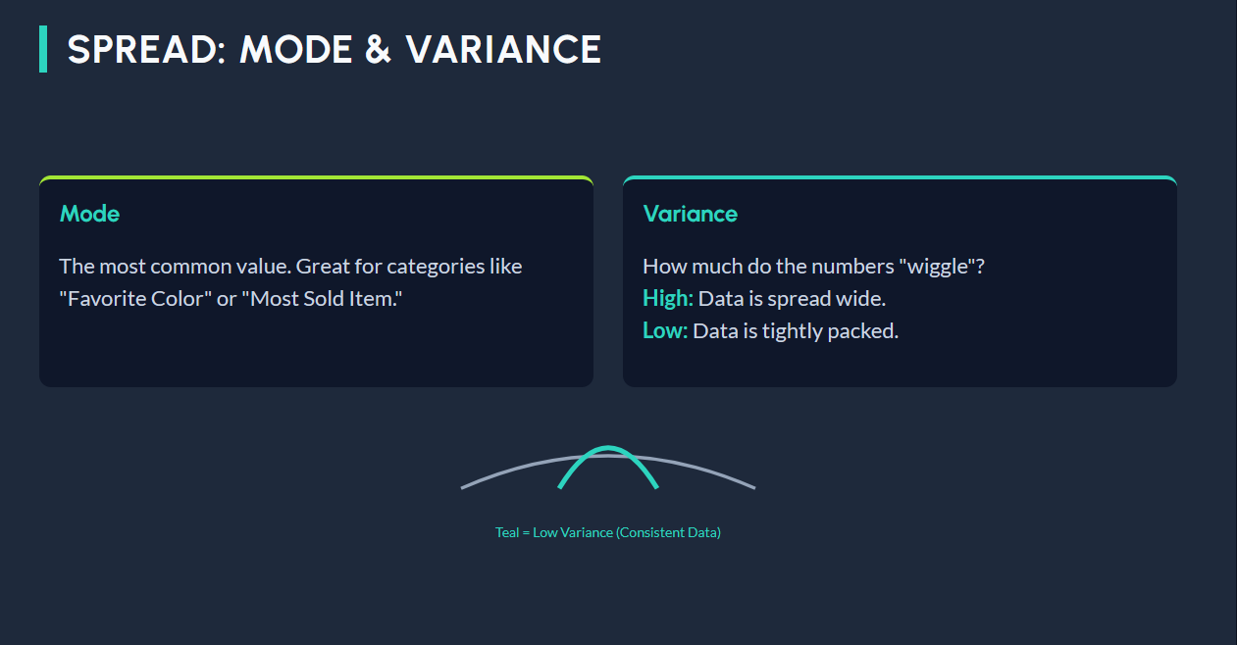

Slide 7
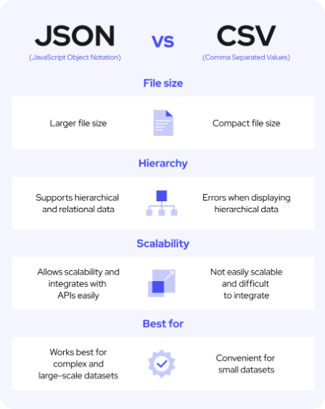



DATA STORAGE FORMATS
CSV (Comma Separated)
The "Shopping List" format. Simple rows and columns.
JSON (Key-Value)
The "Filing Cabinet" format. Hierarchical and flexible.

Slide 8

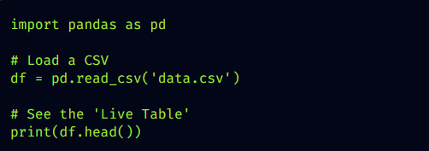
THE PANDAS "DATAFRAME"
A DataFrame is the 2D table that exists in your computer's memory while you code.
It "activates" a CSV so you can: • Filter rows instantly • Calculate averages • Merge multiple files

Slide 9


THE ESSENTIAL TOOLBOX
1. Pandas: Your table manager.
2. NumPy: The engine for fast math.
3. Scikit-learn: The ML Brain.

Slide 10
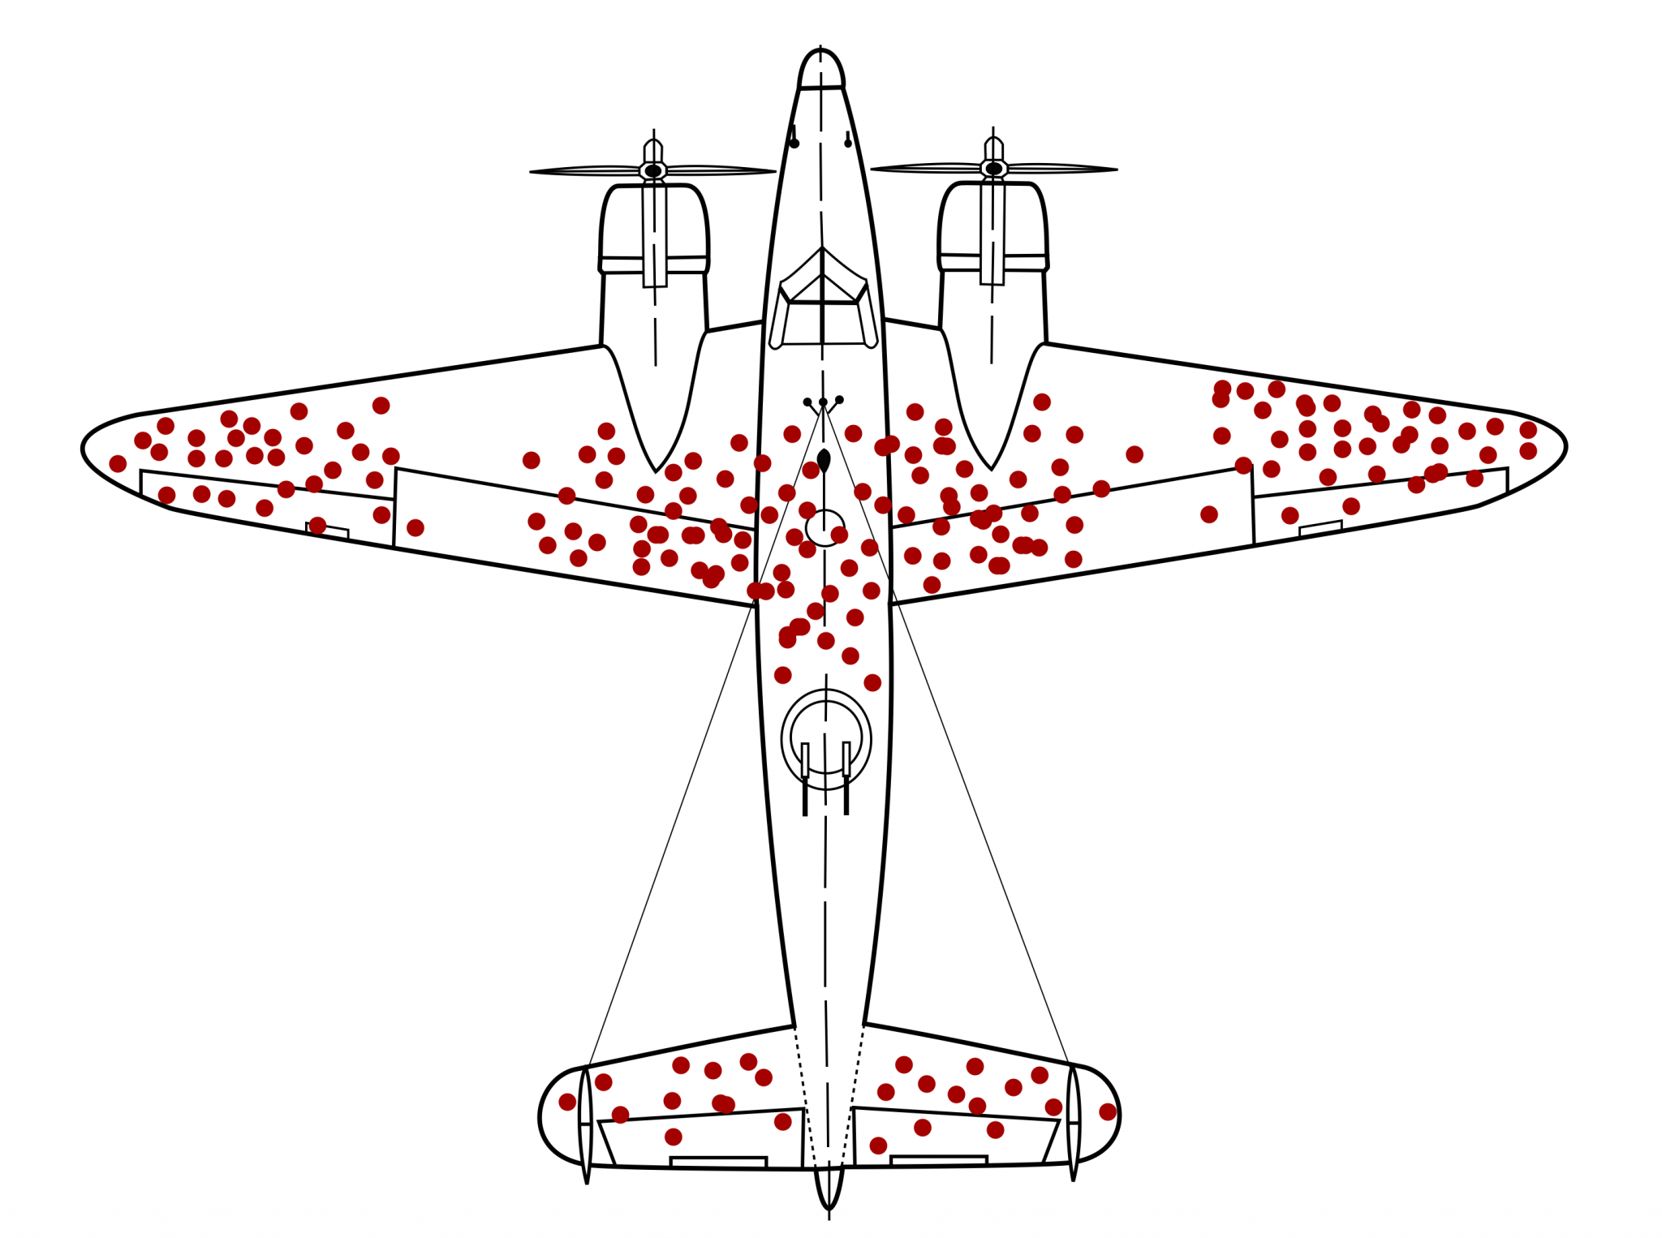

Slide 11

STEP 2: EXPLORATION (EDA)
Before modeling, we must look at the data to find:
Missing Values
Distributions
Are there gaps (NaN) in the rows?
Is the data balanced or skewed?
Outliers
Correlations
Are there impossible values (Age: 999)?
Do two columns move together?

Slide 12
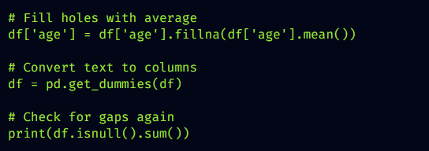
EDA: CODING Example

Slide 13
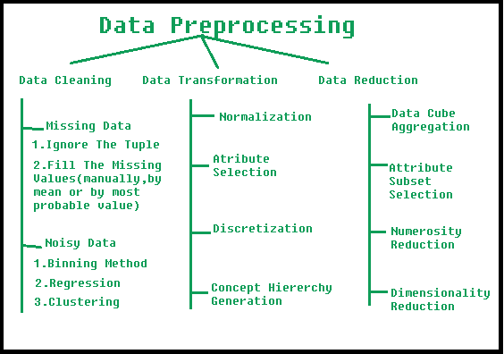
STEP 3: PREPROCESSING

Slide 14
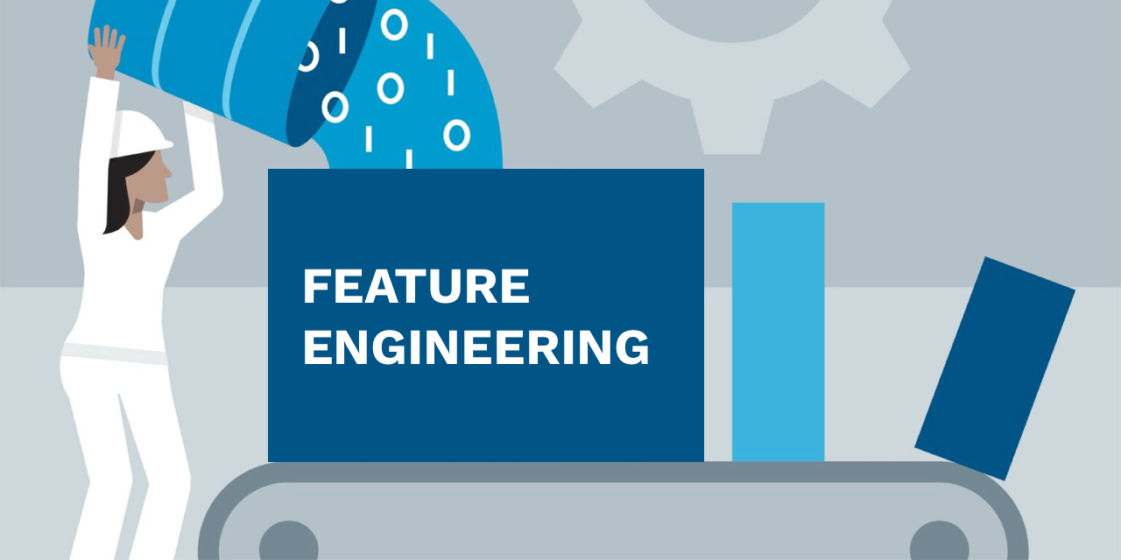

Slide 15
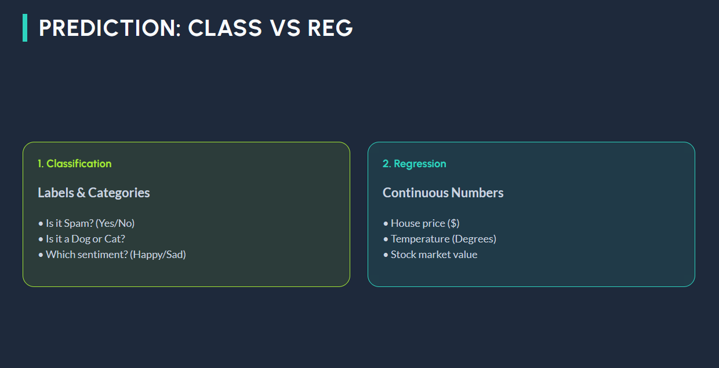

Slide 16
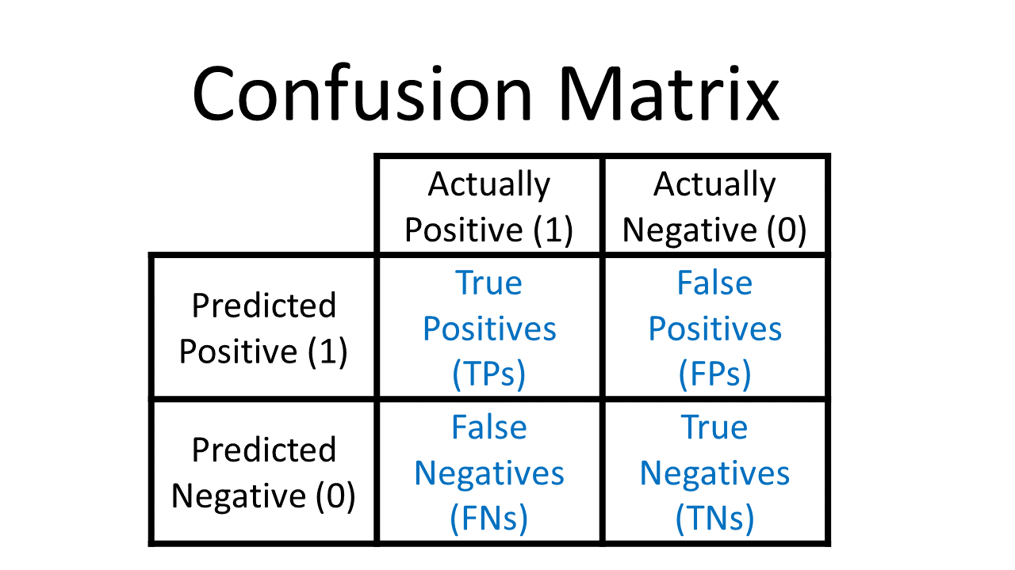

Slide 17
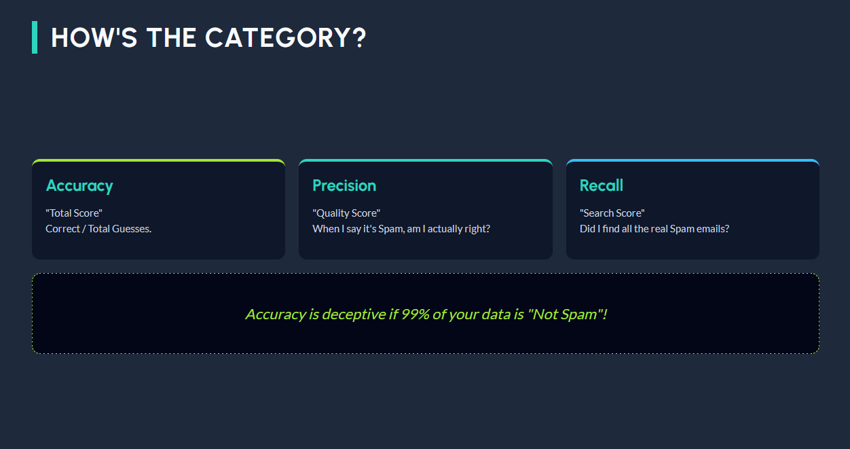
Notes:
Accuracy= Correct/All Predictions
Precision= True Positives/All Positives
Recall= True Positives/ True Positives+ False Negatives

Slide 18
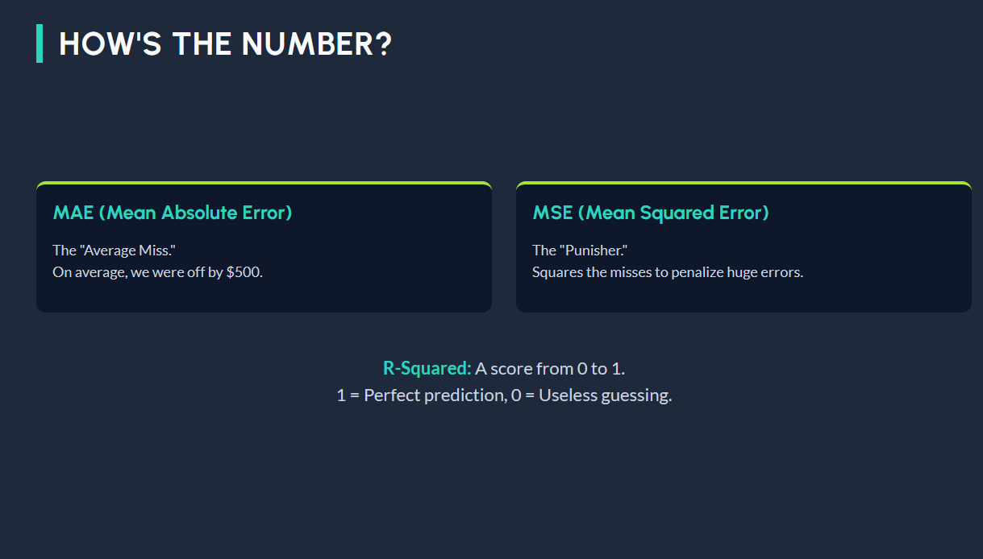

Slide 19

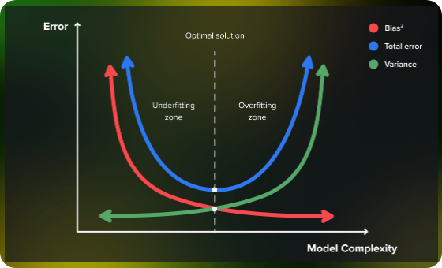
BIAS VS VARIANCE
Bias (Underfitting): The model is too simple. It misses the target entirely.
Variance (Overfitting): The model is too complex. It memorizes noise but fails on new data.
Goal: The Sweet Spot in the middle!

Slide 20

STEP 4: EVALUATION
How do we know if we succeeded? The Golden Rule: Never test on data the model has already seen.
The 80/20 Split
80% of data for Training. 20% for Testing.

Slide 21

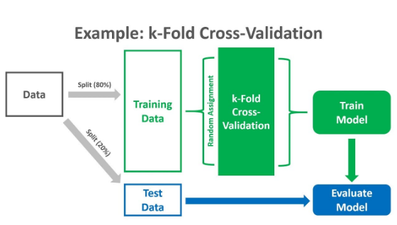
K-FOLD CROSS VALIDATION
Don't just test once! Split your data into 5 or 10 "folds."
Rotate the testing set so every piece of data gets a chance to be the "judge."
This prevents getting a "lucky" split and gives a more honest performance score.

